Slide 1



De Filippo Gaetano Mat. 0522501525
Baggiano Antonio Mat. 0522501526
IoT Safe Locker
Lab Of IoT Project

Slide 2

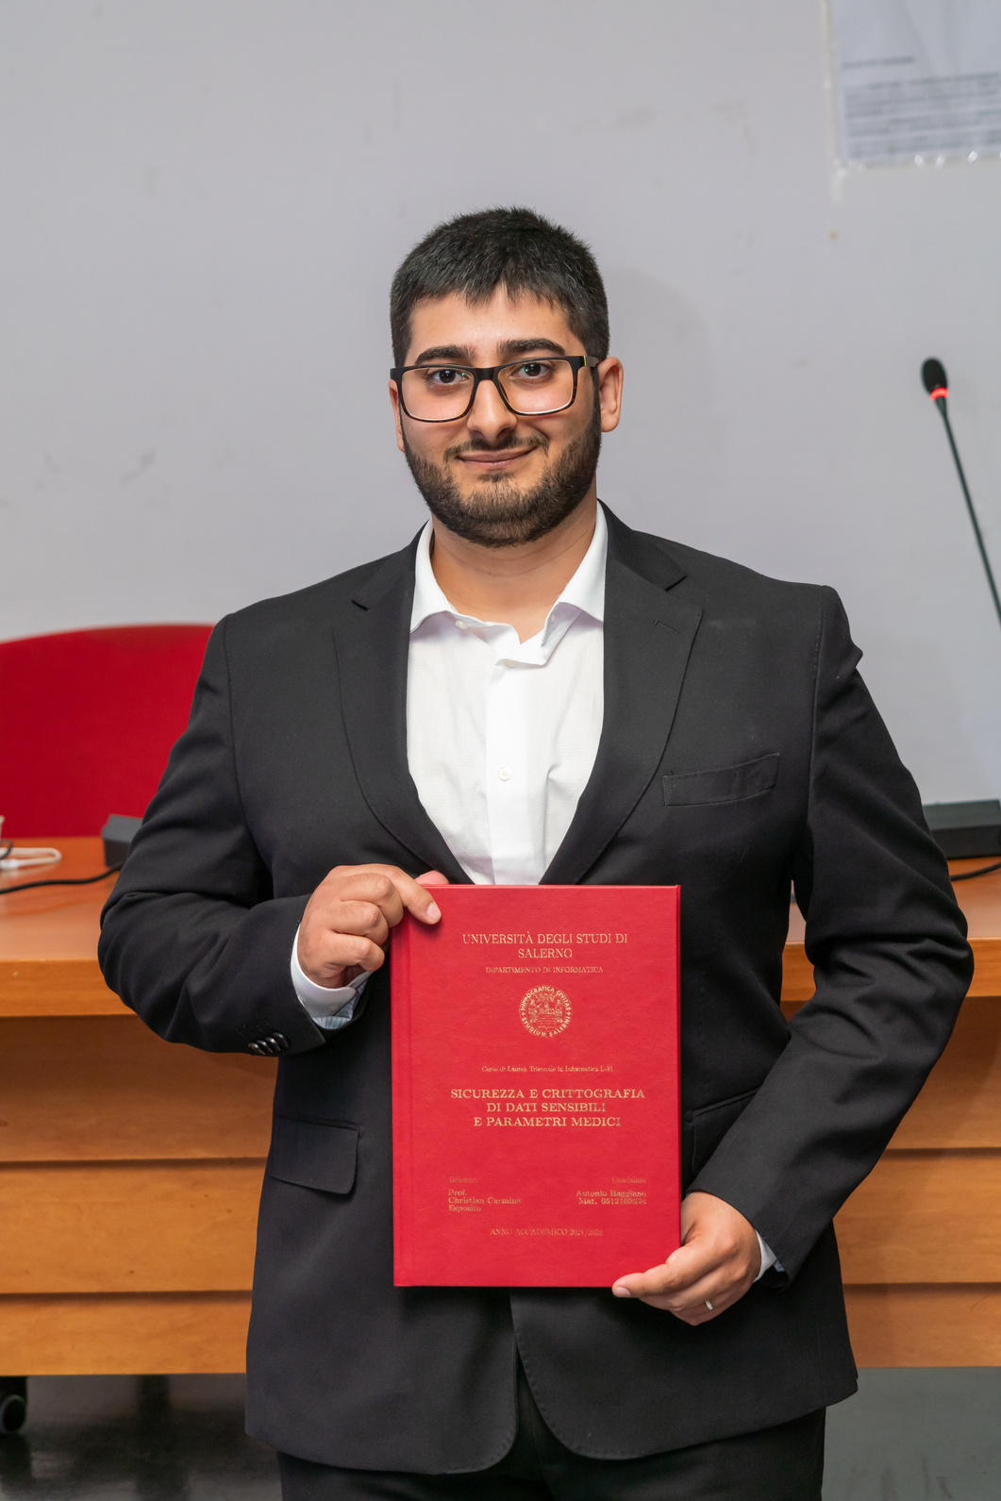
The Team
De Filippo Gaetano
Baggiano Antonio
Mat. 0522501525
Mat. 0522501526

Slide 3
Our Goal
The Secure Box project aims to transform a conventional security box into a smart solution, enhancing it with advanced features to improve security and simplify usage.
Traditional boxes are limited in their ability to protect contents as they rely solely on the physicality of the lock to ensure security. However, this approach is often vulnerable to attacks and key loss, compromising the protection of the items inside.

Slide 4

Our Implementation Ideas
KEYLESS ACCESS
ENHANCED SECURITY
ENVIRONMENTAL MONITORING
REMOTE MANAGEMENT
Eliminate traditional key-based access by integrating a servo motor system to lock and unlock the door electronically.
Implement a two-factor authentication system utilizing both password and fingerprint recognition for superior security measures.
Incorporate sensors to monitor humidity and temperature levels inside the box, ensuring optimal conditions for stored items.
Enable comprehensive control and monitoring of the box via a Node-RED server, providing remote access and management capabilities.

Slide 5
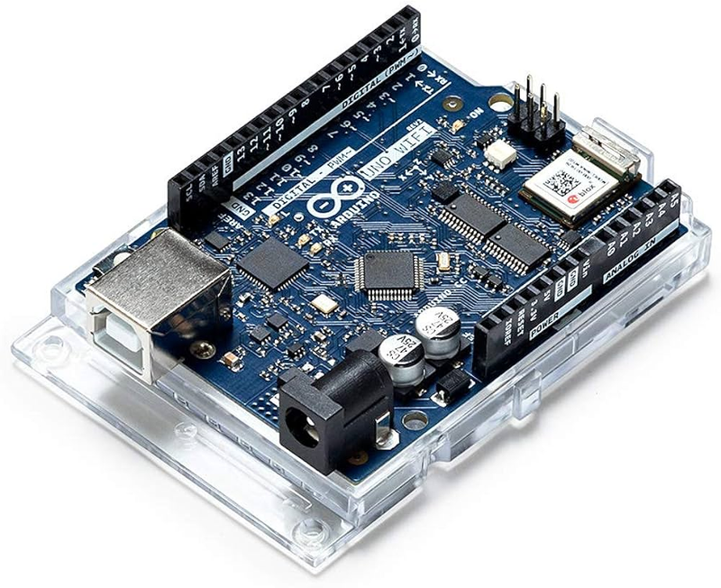
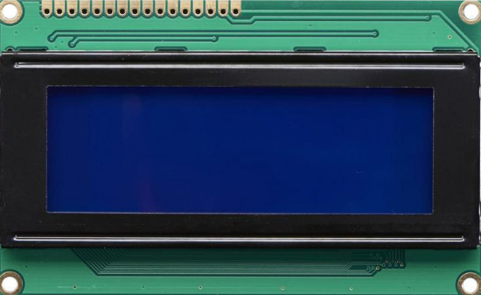
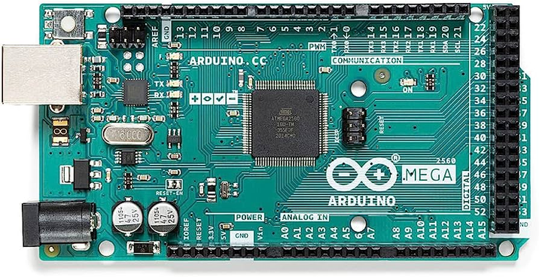
All three components are linked using the I2C communication protocol.
Enables efficient bidirectional communication between devices.
Hardware used
ARDUINO MEGA 256
ARDUINO UNO REV2 WIFI
20X4 LCD SCREEN
The main controller managing the system's operations.
Acts as a master device to coordinate communication.
Integrated WiFi module for wireless connectivity.
Functions as a slave to receive commands and send data to the Arduino Mega.
Provides a visual interface to display important information.

Slide 6
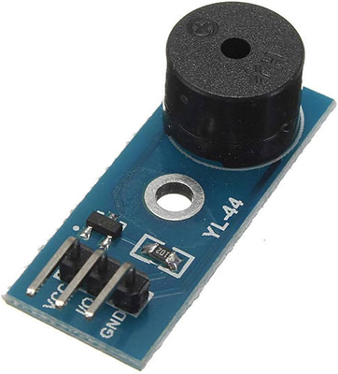
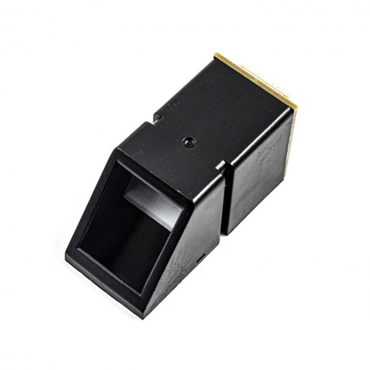
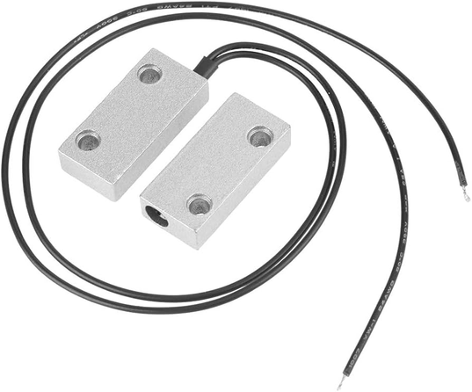
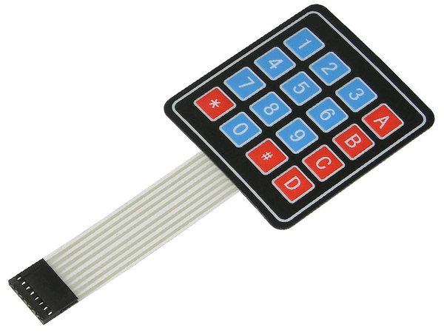
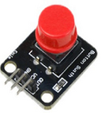
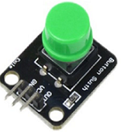
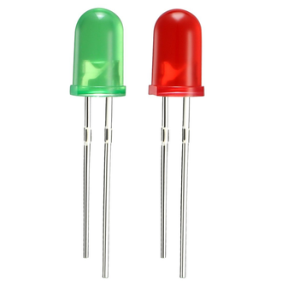
Hardware used
Sensors connected to the Arduino Mega:
BUZZER
BUTTONS
FINGERPRINT SENSOR
KEYPAD
MAGNETIC BUTTON
A biometric sensor that captures and stores fingerprints for personal identification purposes.
A numeric keypad consisting of 16 keys used for inputting codes or combinations.
A magnetic sensor used to detect the status of the door (open or closed) by sensing the presence or absence of a magnetic field.
LEDS

Slide 7
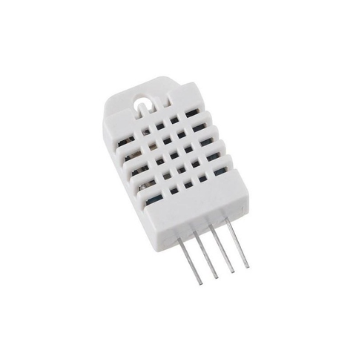

Hardware used
Sensors connected to the Arduino Rev2 WiFi:
This board serves as the slave device in our system. It is utilized to facilitate communication with the Node-RED server since the Arduino Mega lacks a built-in WiFi module.
DHT22 SENSOR
SERVO MOTOR
A digital temperature and humidity sensor that provides measurements of ambient temperature and humidity.
The servo motor is a key component used to control the opening and closing of the box door.

Slide 8
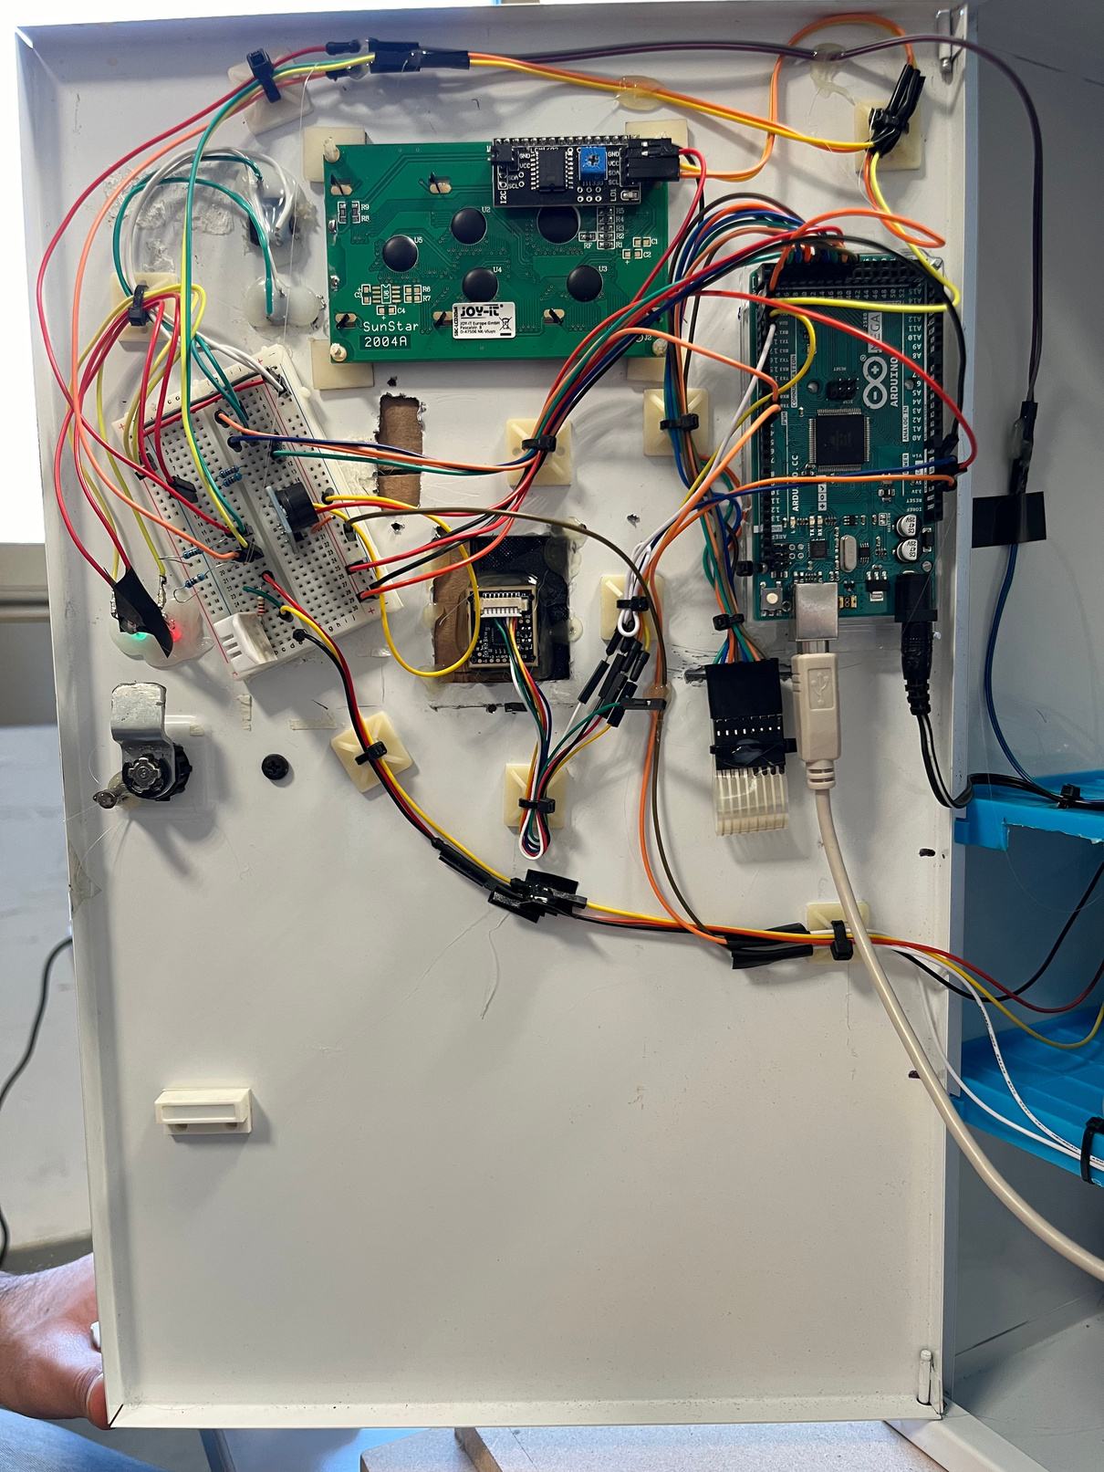
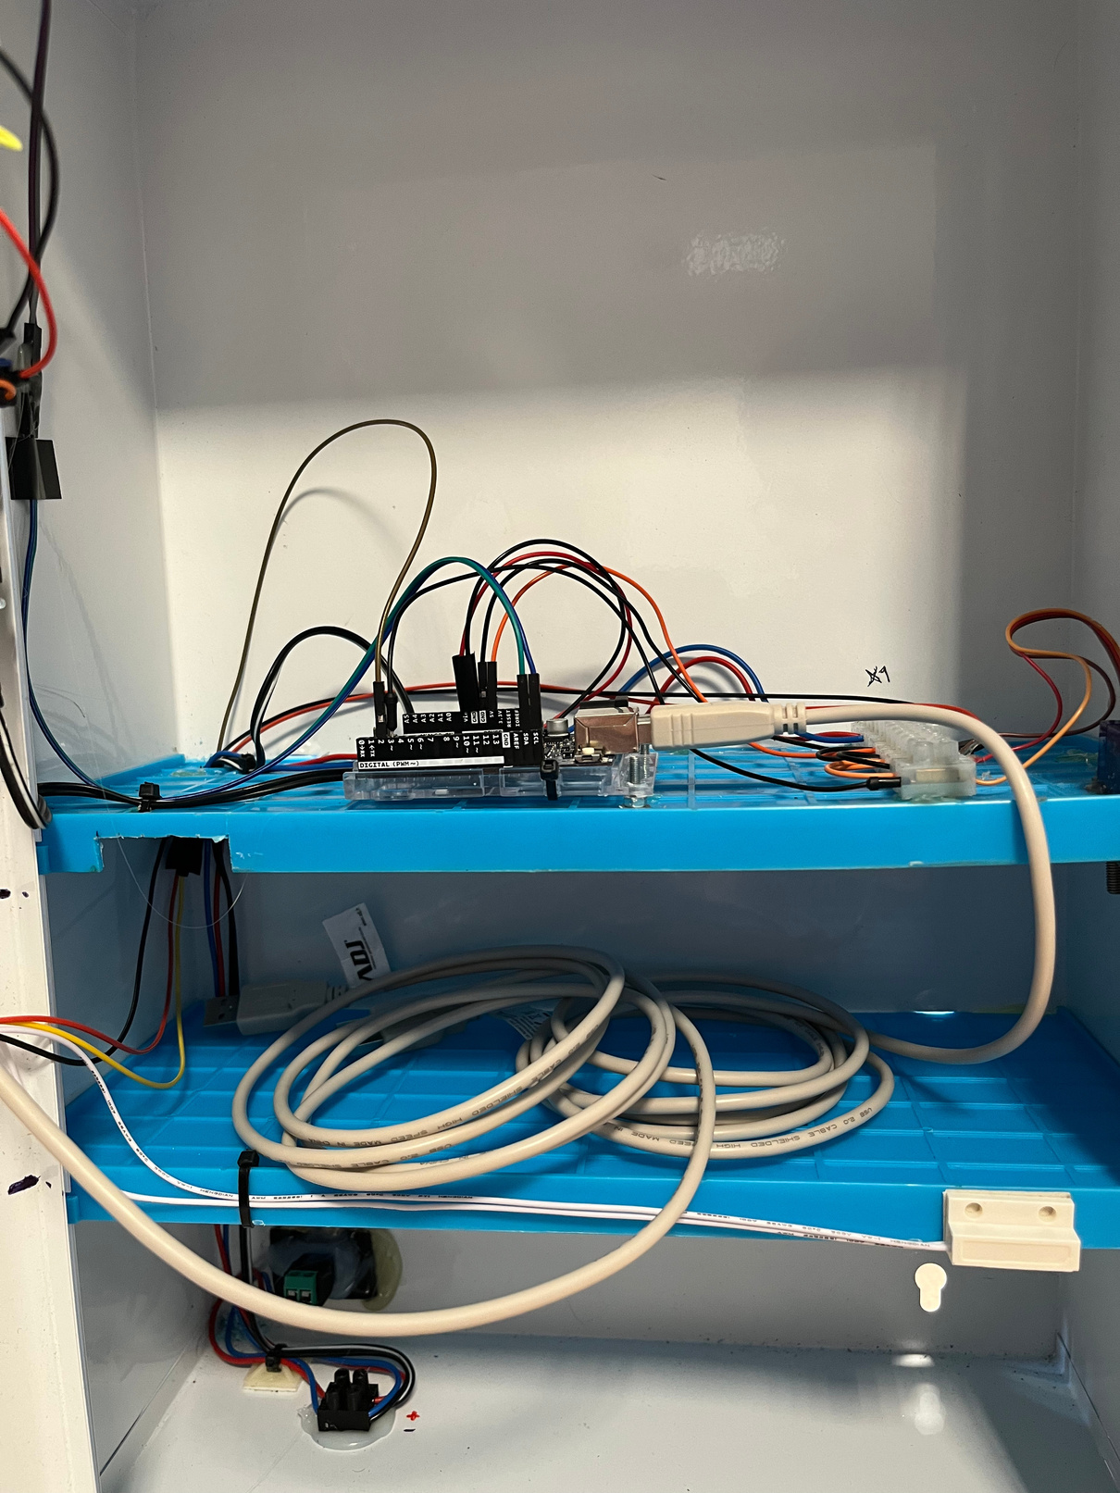
System Architecture
As we can see, the architecture consists of two Arduinos (Mega and Uno_Rev3) connected via I2C. The Arduino Mega acts as the Master and controls the entire system, being connected to all the sensors and actuators (except the ServoMotor). The Arduino Uno, on the other hand, acts as a bridge to communicate with the MQTT broker.

Slide 9
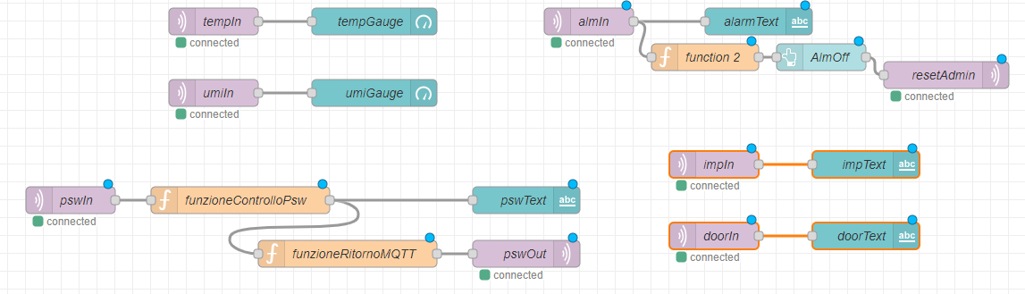
Node Red Architecture
The architecture on Node-RED is very simple. We have created a topic for each function in order to simplify listening from Node-RED and reading responses from Arduino. Currently, the password is hardcoded within the function on Node-RED, but in the near future, it will be easily upgradable to a password that can be updated by the user.

Slide 10
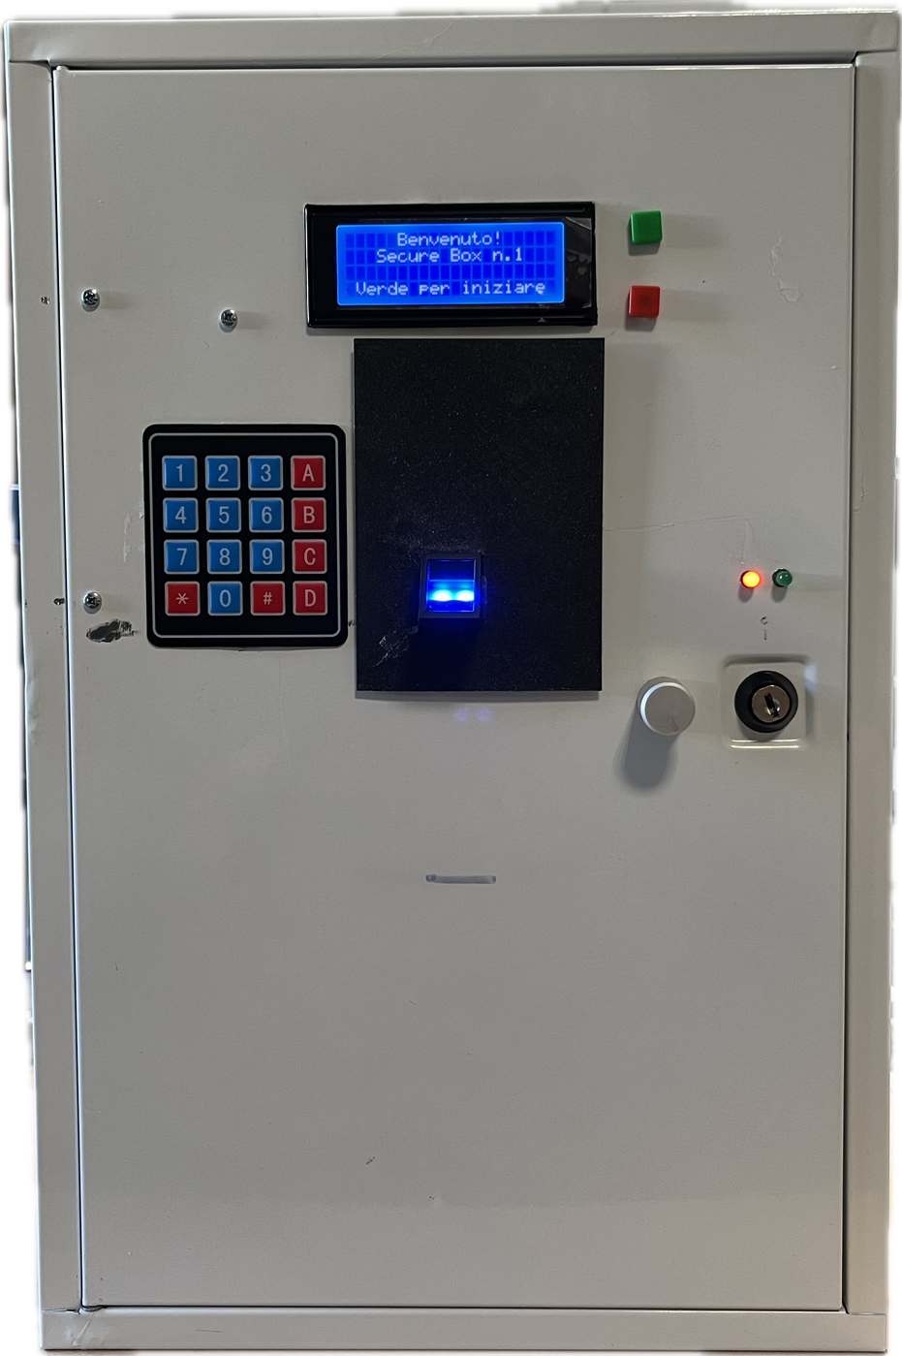
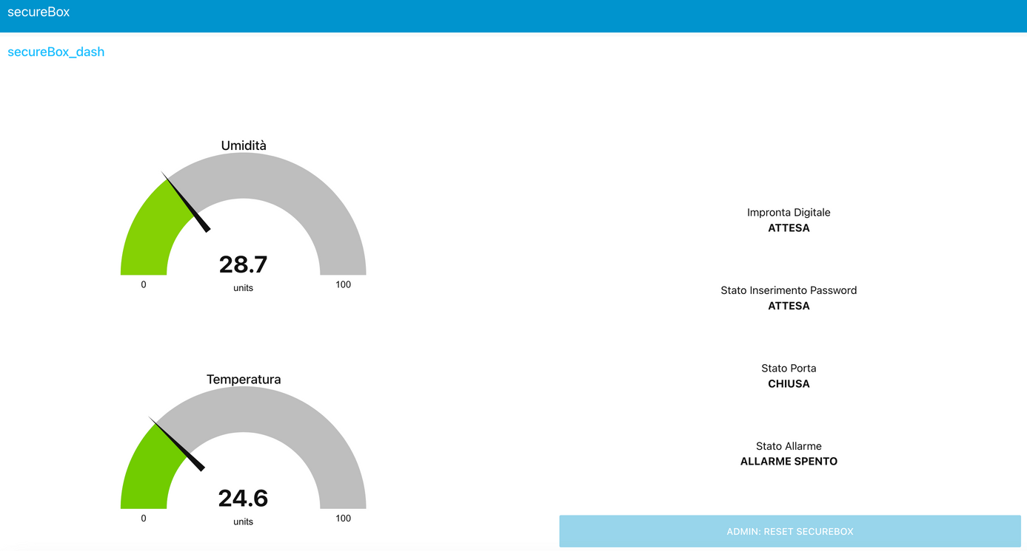
The User Experience
For the user, managing the safe box is very easy. A convenient LCD will provide all the information needed to open, close, and manage the individual safe box, while a dashboard on Node-RED will help administrators manage all the information regarding the safe box and intervene as needed to unlock it in case of problems.

Slide 11



Fingerprint Authentication Process
MQTT CLIENT
I2C comunication: IMP_OK
Fingerprint check
Publish:
secureBox_impronta
MQTT CLIENT
Publish:
secureBox_impronta
Subscribe:
secureBox_impronta
MOSQUITTO BROKER

Slide 12

KeyPad Password Authentication
MQTT CLIENT
I2C comunication: IMP_OK
Fingerprint check
Publish:
secureBox_pswCheck
Publish & Subscribe:
secureBox_pswResult
MQTT CLIENT
Publish & Subscribe
secureBox_pswCheck
Publish:
secureBox_pswResult
Password check
MOSQUITTO BROKER

Slide 13
Temperature & Humidity Control
MQTT CLIENT
MOSQUITTO BROKER
MQTT CLIENT
Publish:
secureBox_temperatura
secureBox_umidita
Publish:
secureBox_impronta
Subscribe:
secureBox_impronta

Slide 14
Door Status
MQTT CLIENT
I2C comunication:
DOR_OP
Publish:
secureBox_porta
MQTT CLIENT
Publish:
secureBox_porta
Subscribe:
secureBox_porta
MOSQUITTO BROKER

Slide 15
Future Developments
01
ENHANCED SECURITY PROTOCOLS
Implement advanced security protocols to encrypt sensitive data such as passwords during transmission, ensuring higher levels of data protection and integrity.
02
INTEGRATION OF ARDUINO MEGA WIFI
Integration of Arduino Mega WiFi: Explore the possibility of replacing both Arduino boards with a single Arduino Mega WiFi unit. This consolidation aims to simplify hardware integration, enhance system efficiency, and eliminate the need for interconnecting multiple Arduino boards via I2C.
03
NETWORK EXPANSION
Explore the possibility of creating a network of interconnected secure boxes to enhance scalability and functionality.

Slide 16
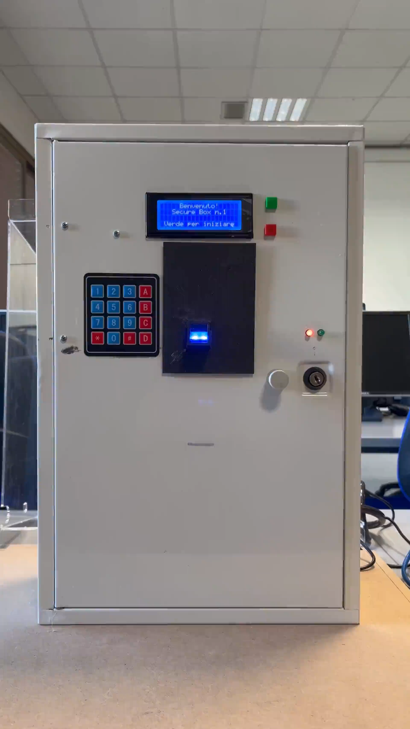
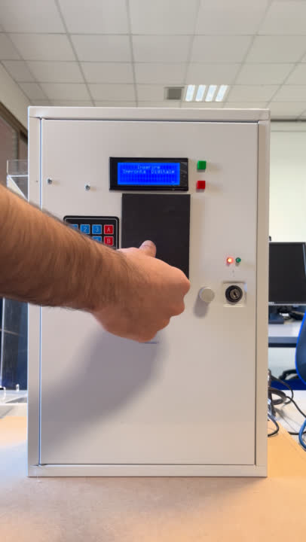
Correct Opening
This video demonstrates the correct opening of the safe box. After providing a correct fingerprint, you need to enter the password which, if correct, will lead to the door opening prompt.

Slide 17
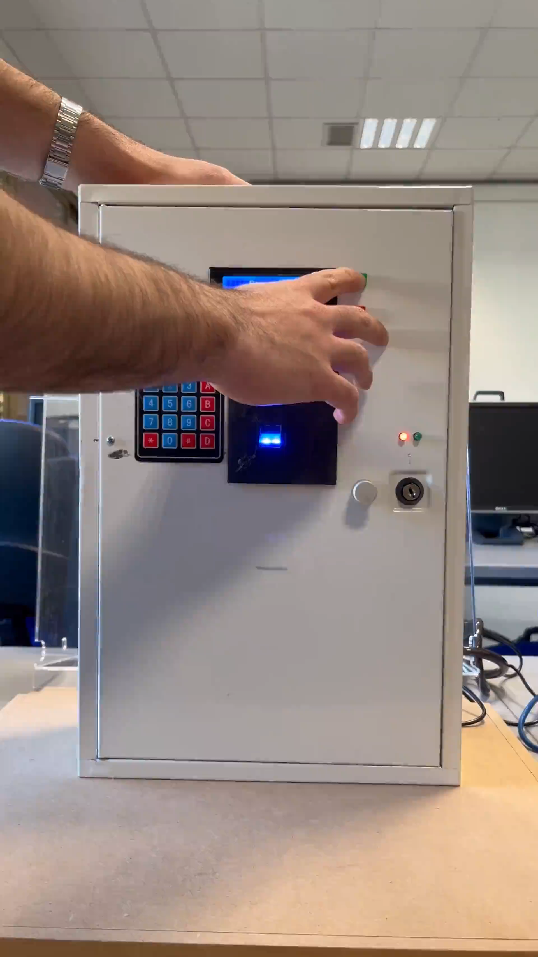
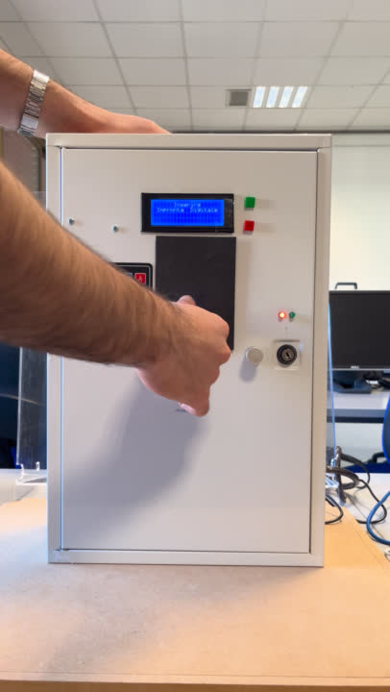
Fingerprint Enroll
We have provided the ability to add additional fingerprints. After entering a valid one, programming mode is entered by entering a predetermined code 'BA#123', which takes us to the programming of a new fingerprint. Once the fingerprint is stored, a counter is updated in the EEPROM of the Arduino Mega.

Slide 18
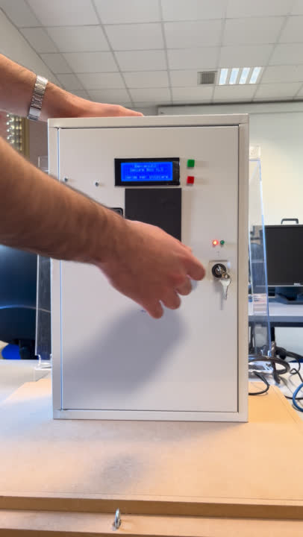
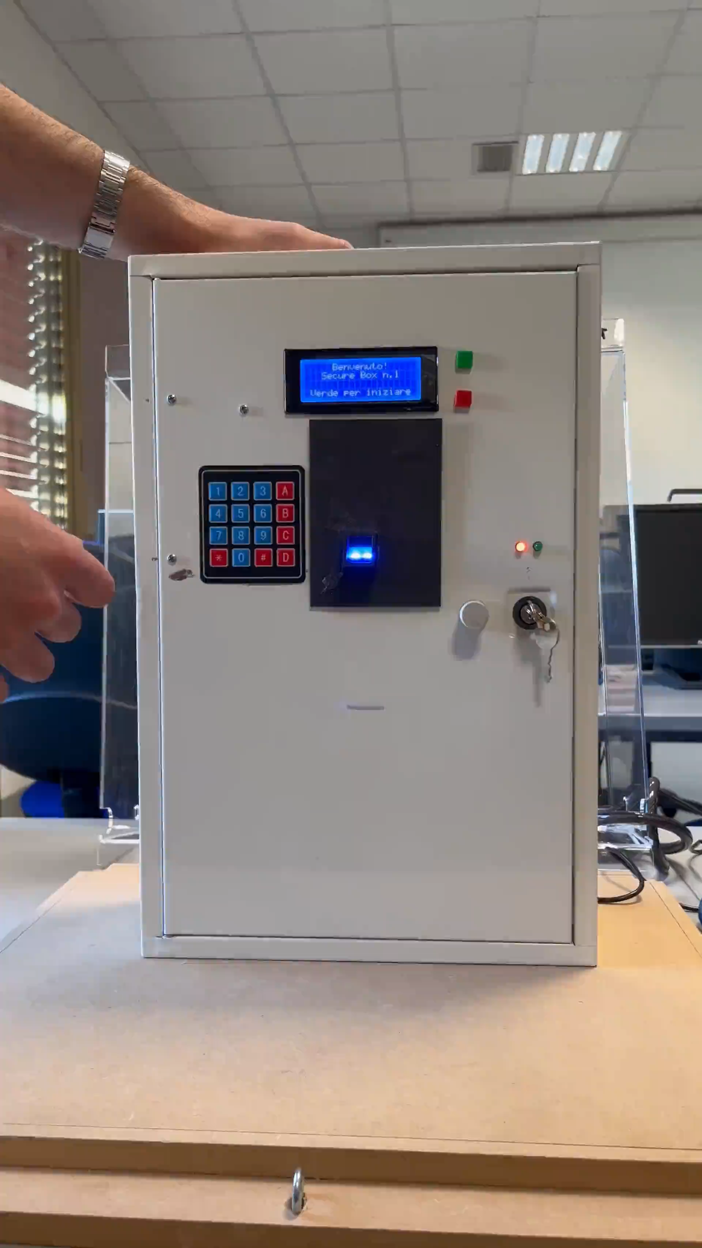
Intruder Detection
To detect intrusions and update values on Node-RED, a magnetic sensor is installed on the door opening. If the door is opened at any time but the login phase has not been completed correctly, an audible alarm will sound, and an administrator will be notified via Node-RED. Only the administrator will be able to unlock the safe box again.

